Slide 1








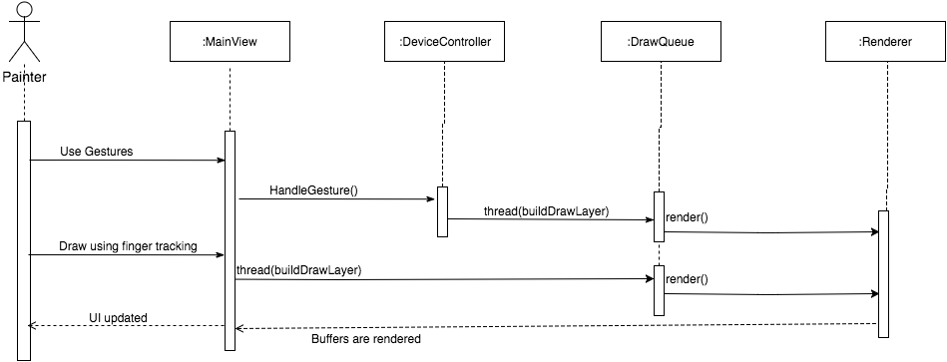
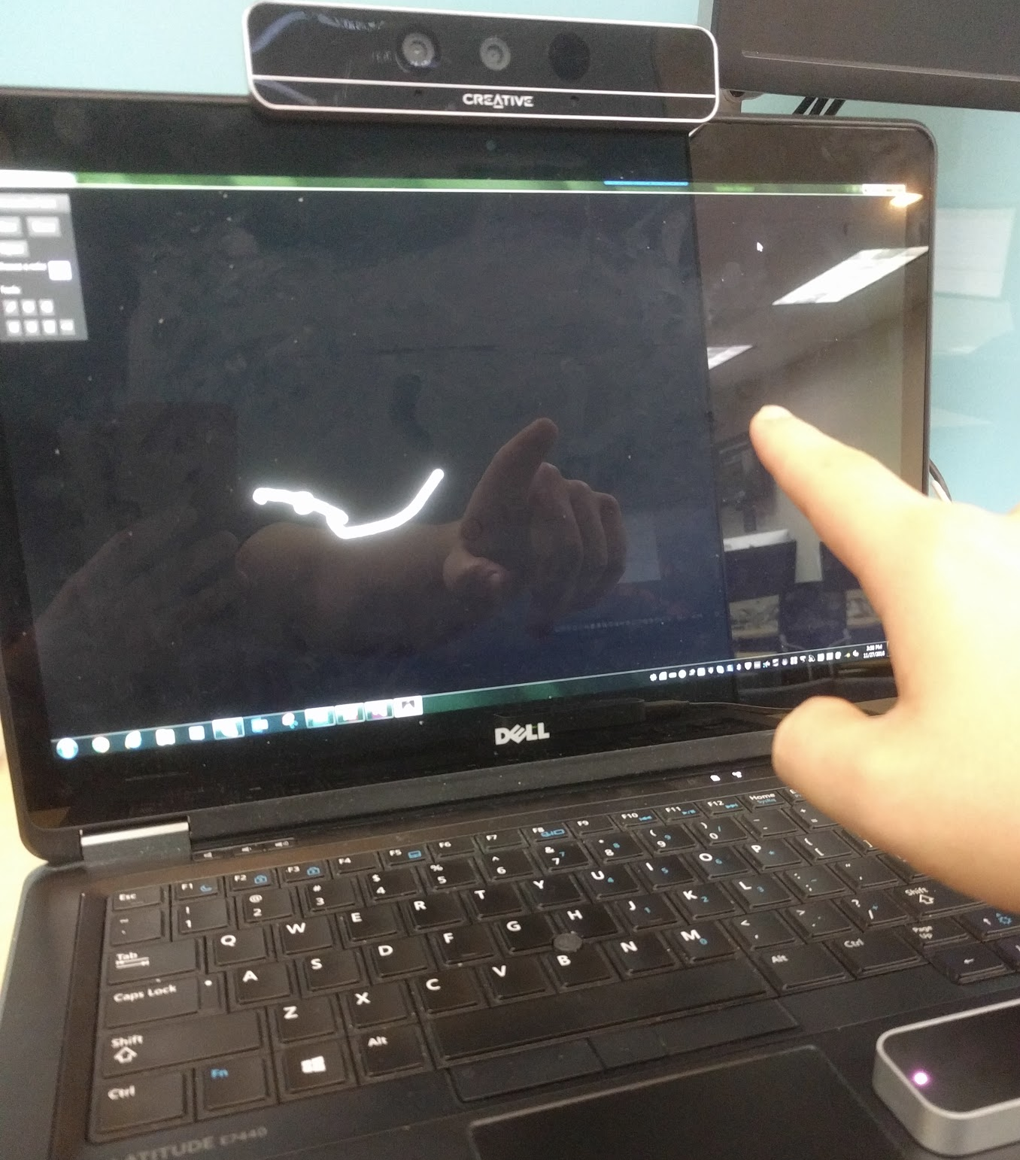
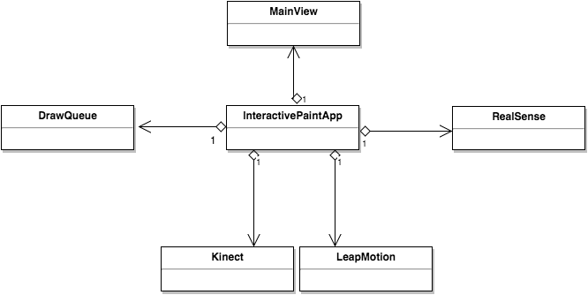
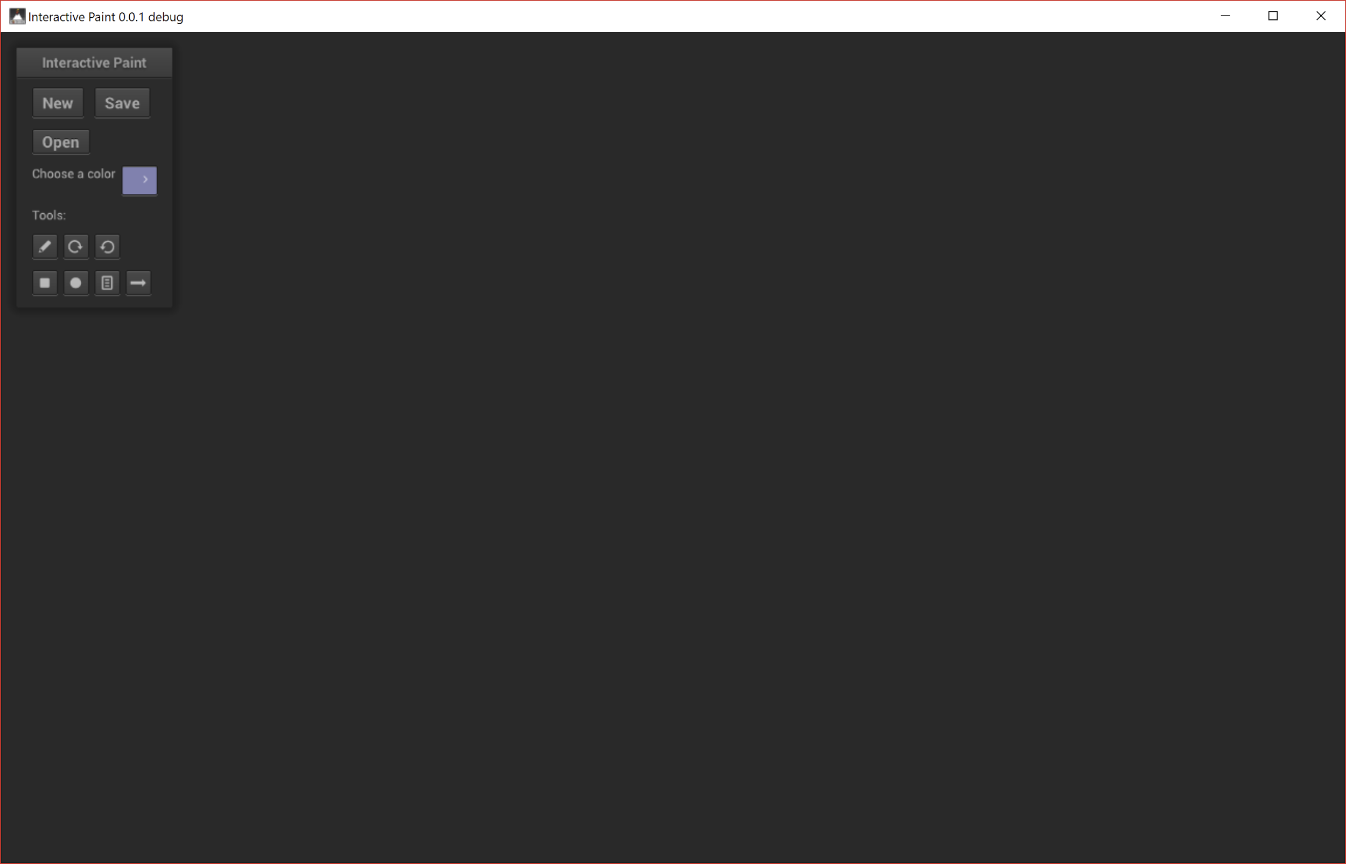
Senior Project, 2016, Fall
Interactive Paint
Jose Morgan, Florida International University
Francisco Ortega, Florida International University
Masoud Sadjadi, Florida International University
Problem
Implementation
Requirements
Devices such as VR headsets and motions sensors are becoming very accessible but software that makes use of these devices is limited.
Interactive Paint is a showcase of what can be done using modern input devices as well as a framework for future applications using these input devices.
The application is built entirely in C++ with the logic for handling the input devices decoupled from the actual application.
If the application were rebuilt or extended developers can spend the bulk of their time making use of the new graphics APIs and building a working application.
Implementation of gestures:
Application must be built modular enough that the code can be reused in future iterations.
Drawing should be possible using hand tracking on the input devices that support hand tracking.
Gestures should be supported by the application.
Support for multiple users with different input devices.
System Design
Validation
The main goal behind the system design was to build a framework for future iterations of the project. Rendering of concurrent drawing was done using the DrawQueue and all input devices are implemented as separate classes which are not coupled to the rest of the application.
Multiple users used the application for several minutes at a time.
There were also a few unit tests for the input device components as well as the DrawQueue.
DrawQueue execute method
DrawQueue vector filled with {(20,20), (30,30), (40,40), (50,50)}
Expected Result: White dots on screen at positions 20, 20; 30, 30; 40, 40; and 50, 50.
Actual Result: On the screen there were white dots at positions 20, 20; 30, 30; 40, 40; and 50, 50.
Drawing using hand tracking
Summary
Current System
Interactive Paint shows what modern input devices are capable of as well as what their limitations are.
Future iterations of this application will hopefully show how far we’ve been able to move forward when it comes to this kind of technology.
Augmented reality provides a great experience and as these devices improve Interactive Paint should improve with future iterations.
The application supports a wide variety of input devices. The multi-touch display, Microsoft Kinect, Leap Motion and Intel RealSense.
The current build of the application has a few limitations based on the limitations of the input devices. These devices are very sensitive to distance and lighting conditions.
Screenshot of the user interface of Interactive Paint
Acknowledgement
The material presented in this poster is based upon the work supported by Dr. Francisco Ortega. I am thankful to the help that I received from my group member Justin Alvarez. Special thanks to the OpenHID lab for providing the hardware that made this project possible.

